Slide 1


INSIGHTS INTO BEACH VOLLEYBALL DATA
BUILDING R PROJECT FOR DATA VISUALIZATION
Prepared by Sama Alqaisi
June, 2024

Slide 2

BEACH VOLLEY BALL
Most of the data is from the international FIVB(International Volleyball Federation, It governs and organizes international volleyball competitions,) tournaments but about 1/3 is from the US-centric AVP(Association of Volleyball Professionals, It is a professional beach volleyball tour and league in the United States).
single matches played by two teams, with each team comprising two players, the data as I mentioned contains information for both the winning and the losing team about the tournament details, Match details, player details, match statistics

Slide 3


THE PURPOSE IS TO ANALYZE BEACH VOLLEYBALL MATCHES, UNDERSTAND PLAYERS' PERFORMANCE, AND IDENTIFY TRENDS AND PATTERNS OVER TIME TO GUIDE INSIGHTS TO SHAPE STRATEGIES AND ASSIST IN THE BEACH VOLLEYBALL DECISION-MAKING PROCESS.

Slide 4

INTRODUCTION TO PLAYER DEMOGRAPHICS

Slide 5
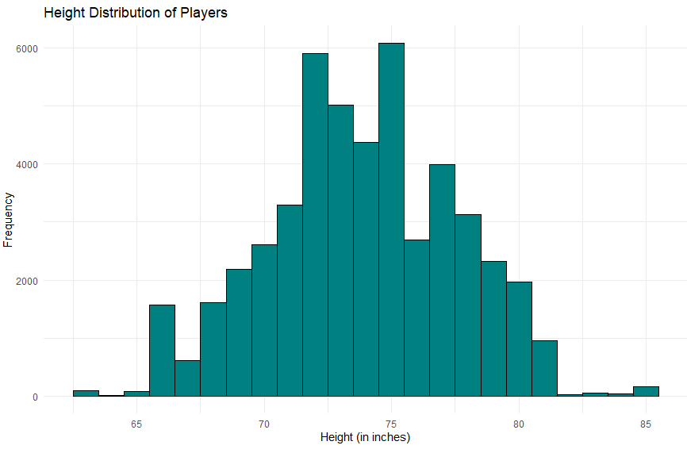

Slide 6

PLAYER AGE DISTRIBUTION
Insights:
The plot demonstrates that the peak of the age distribution is around mid to late 30 which shows that most beach volleyball players are around these ages. Also, there is a noticeable drop-off in the number of players as the age increases beyond 35.
Formed Decision:
  The stakeholders should focus on younger players, specifically targeting the age group of early 20s to mid-20s in their training programs as they are the most likely to participate in upcoming competitions.
  For the players in their late 20s and early 30s, the stakeholders should think of creating a support program to extend the player's careers.

Slide 7
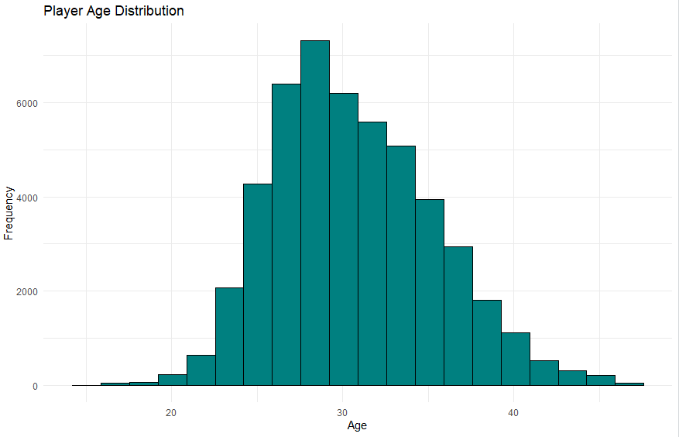

Slide 8
HEIGHT DISTRIBUTION OF PLAYERS
Insights:
The plot demonstrates that the height distribution for players is that most players are between 70 to 80 inches tall, with a small skew toward the taller players.
Formed Decision:
  The stakeholders should focus on putting strategies for recruitment targeting tall athletes as it appears that height is a significant factor in the player field.
  In the training, do a specialized session for taller players to focus on blocking and attacking skills

Slide 9
PERFORMANCE ANALYSIS

Slide 10
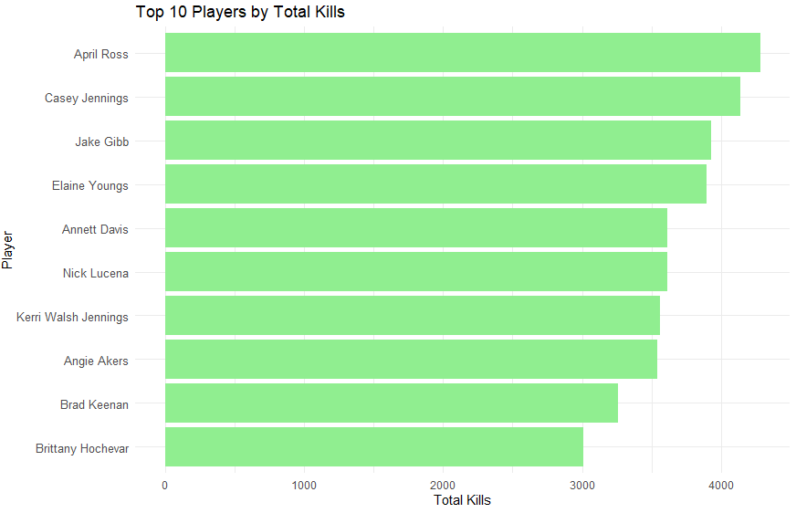

Slide 11
TOP PLAYERS BY TOTAL KILLS
Insights:
The data shows that the top 10 players are consistently dominating in terms of offensive performance which is impacting the team's success. Also, the players show a great performance of constancy in their ability to score points through attacks.
Formed Decision:
The decision is to use the top performers' playing styles and techniques to train and develop the other players’ offensive skills.

Slide 12
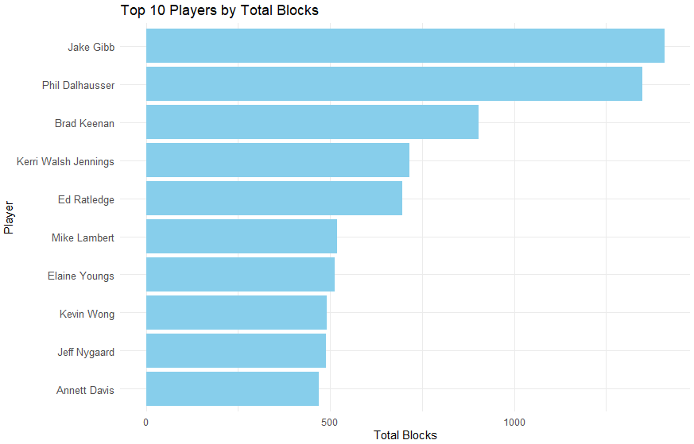

Slide 13
TOP PLAYERS BY TOTAL BLOCKS
Insights:
The data shows that the top players are very important for their team's defensive strategies, and it shows that they are always performing well in blocking the opponent’s attacks.
Formed Decision:
The decision will include using the defining skills of the top blocking performers in building team strategies. As well as develop training sessions for the other players focusing on their blocking skills to enhance the overall team defense.

Slide 14
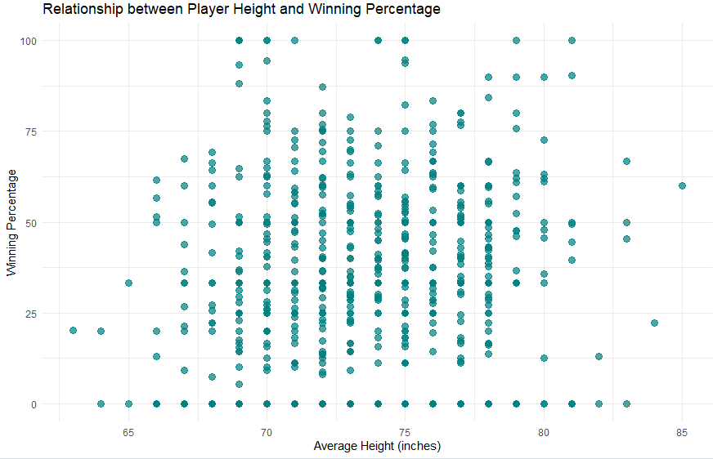

Slide 15
PLAYER HEIGHT VS. WINNING PERCENTAGE
Insights:
As shown from the plot there is a high correlation between the winning percentage and the height of taller athletes, which indicates that having tall players will tend to have more winning match outcomes.
Formed Decision:
The decision based on these insights is to have training programs to maximize the potential of shorter players to focus on their speed and strategic playing. Also, to put the priority on taller athletes in the scouting time and the priority on developing the skills of these taller athletes to build a competitive team.

Slide 16
COMPETITIVE TRENDS

Slide 17
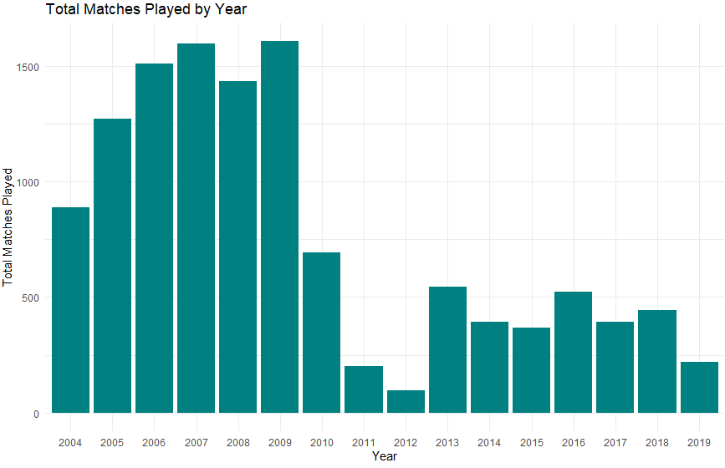

Slide 18
TOTAL MATCHES PLAYED BY YEAR
Insights:
The data shows that there is a general increase in the total number of matches played each year which reflects the growing popularity of this sport also shows that in some years like 2011 and 2012, the number of matches is low which is caused by certain factors.
Formed Decision:
The decisions should focus on the continuous promotion of this sport to gain popularity also keeping in mind having support systems to accommodate the increased number of matches and participants.

Slide 19
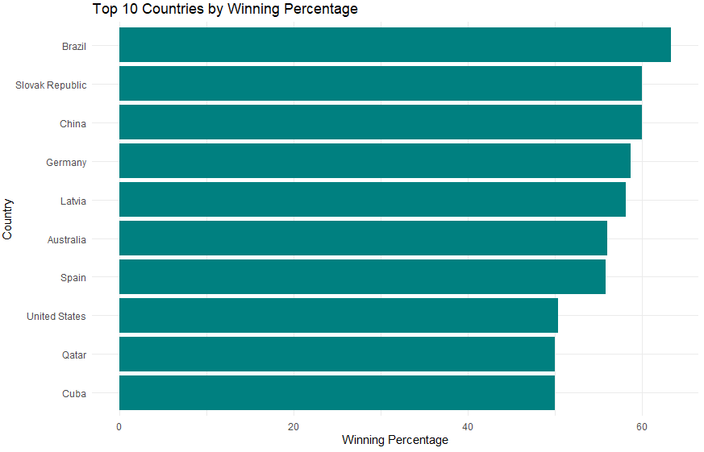

Slide 20
WINNING PERCENTAGE BY COUNTRY
Insights:
The data highlight the predominance of a few countries in international competitions. Also, Some countries consistently show higher winning percentages, indicating strong beach volleyball programs and player development systems.
Formed Decision:
The decisions should focus on training sessions to identify the best strategies for top countries, also having collaborations with successful countries to improve the beach volleyball programs

Slide 21
PLAYER PERFORMANCE OVER TIME

Slide 22
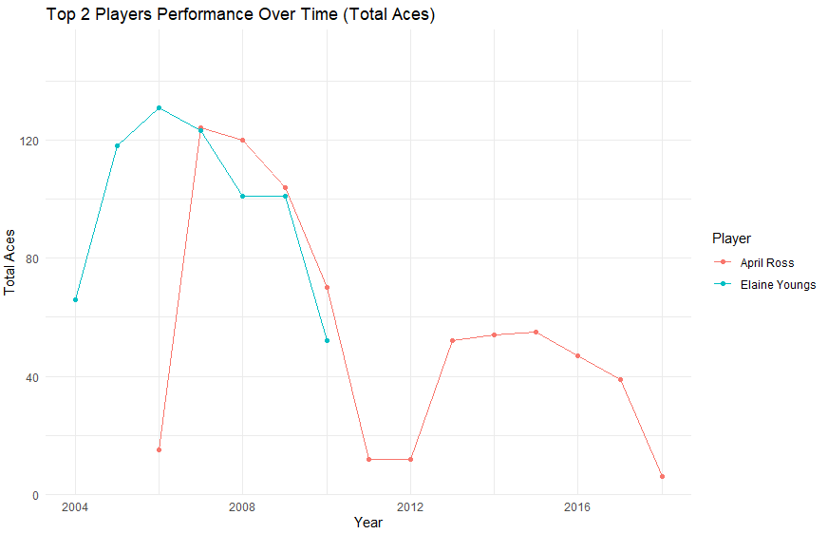

Slide 23
PERFORMANCE OVER TIME FOR TOP PLAYERS (TOTAL ACES)
Insights:
The data shows that these top 2 players show peak performances with some periods also it shows the variations in total aces. Also, the analysis of their performance trends can provide insights into elements contributing to their success.
Formed Decision:
The decisions must use the performance data of the top players to identify key factors and contribute to their success. Also, embrace the best training sessions and practicing and successful strategies from top players in training programs for other athletes.

Slide 24
DETAILED PERFORMANCE ANALYSIS

Slide 25
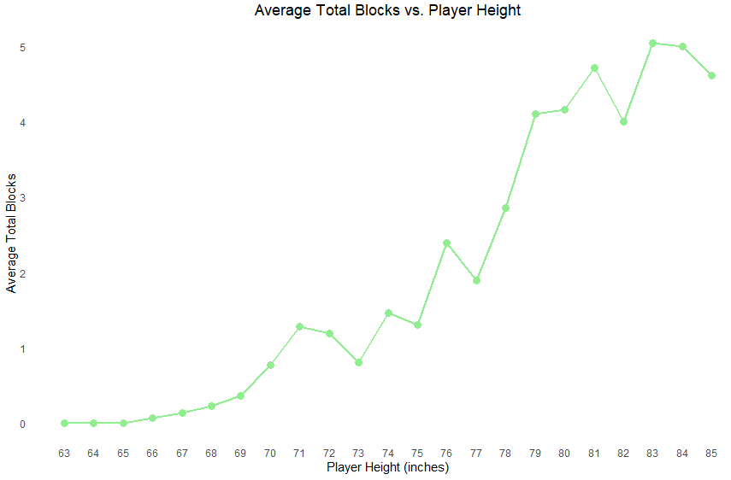

Slide 26
AVERAGE PERFORMANCE METRICS BY PLAYER HEIGHT
Insights:
The data shows a strong relation between the player's height and the average total block, also the taller the player the more they are effective in blocking.
Formed Decision:
The decision should focus on prioritizing the development of the blocking skills of the taller players to improve the defending teams. Also, implementing training sessions that exploit height advantage for blocking purposes.

Slide 27
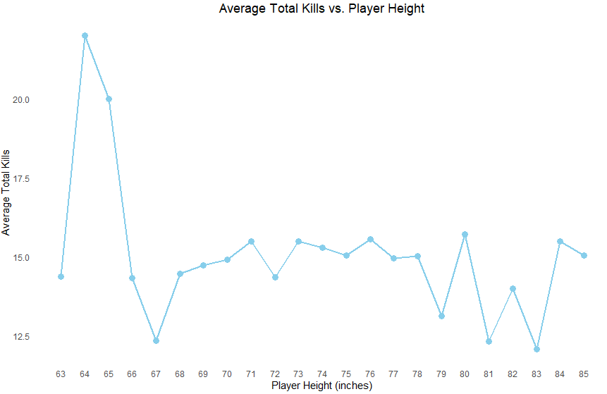

Slide 28
AVERAGE PERFORMANCE METRICS BY PLAYER HEIGHT
Insights:
The data shows that the taller players resort to having a higher average number of total kills, emphasizing the advantage of height in offensive operations.
Formed Decision:
Decisions should focus on utilizing height advantages in the offensive strategies. Also, develop a training session that will focus on enhancing the attack efficiency for the taller players to increase their impact and performance in the matches.

Slide 29
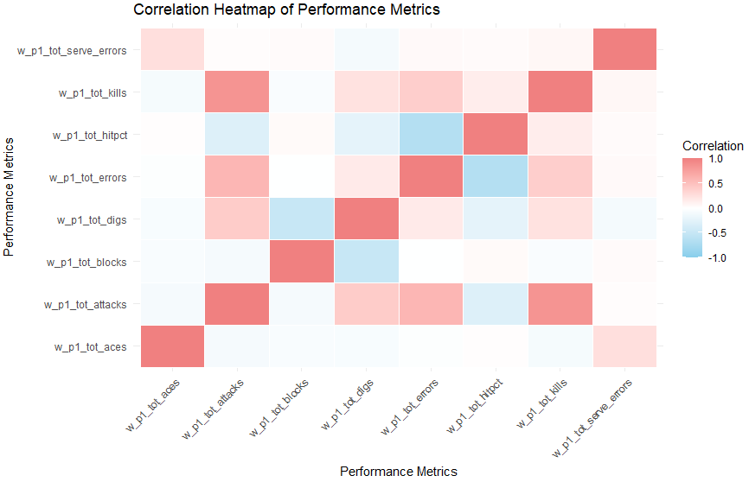

Slide 30
CORRELATION HEATMAP OF PERFORMANCE METRICS
Insights:
It is observed from the plot that the correlations between certain performance metrics are as high as the attacks and kills, which shows that the players who attempt more attacks attend to receive more kills, and so on for the other metrics who are observed to have a high correlation.
Formed Decision:
One of the important decisions regarding these insights is to use these correlations to tailor a specialized training program to focus on metrics that impact the match outcomes.

Slide 31
INTERACTIVE EXPLORATION

Slide 32
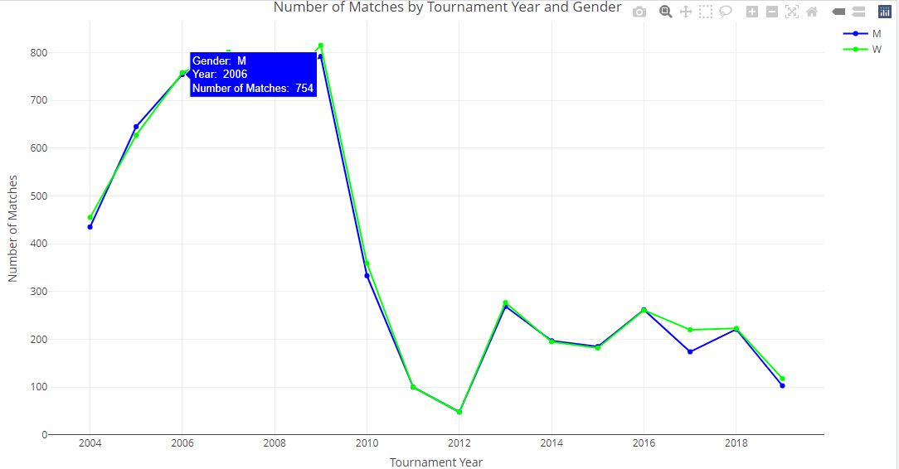

Slide 33
NUMBER OF MATCHES BY YEAR AND GENDER
Insights:
The data shows that the number of matches played each year has a changeable rate of increase which indicates the growing popularity and participation in beach volleyball. Also, both the male and female matches show similar trends over the years.
Formed Decision:
The decisions should focus on continuously promoting and investing in beach volleyball to obtain further increased participation. Also, ensure that these investments are equally distributed between female and male matches to maintain balanced achievements.

Slide 34
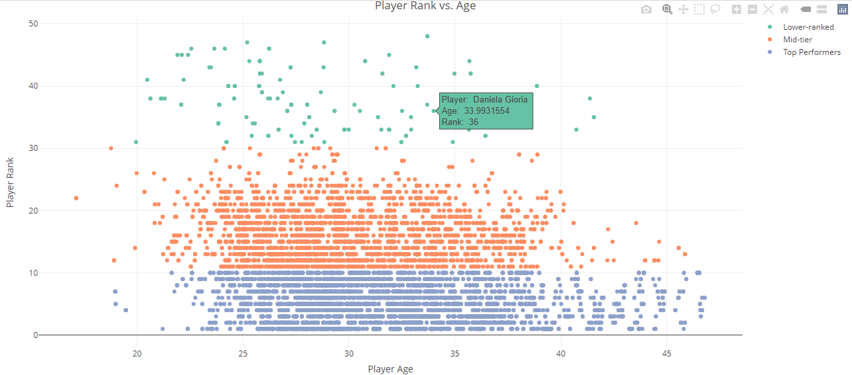

Slide 35
PLAYER RANK VS. AGE
Insights:
The data shows that age can be an important key in performance and ranking which shows that the younger players tend to be the higher-ranked players. Also, shows that there are trends where peak performance is associated with younger age groups, with some exceptions.
Formed Decision:
The decisions should focus on identifying young talents to build a strong group of highly-ranked players for future scouting. Also, developing age-specific training programs that meet the physical and skill development needs of young athletes.

Slide 36
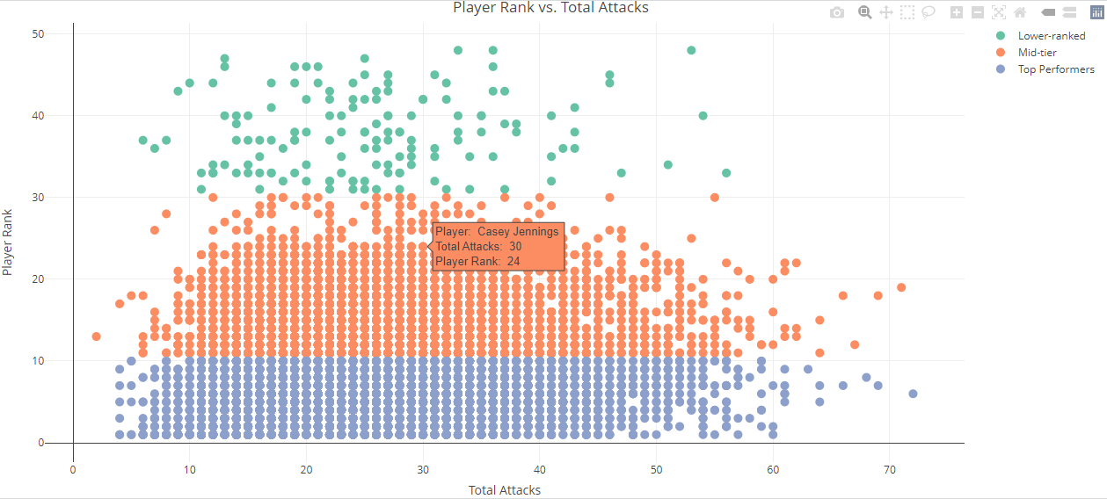

Slide 37
PLAYER RANK VS. TOTAL ATTACKS
Insights:
These insights show that the higher-ranked players mostly have a higher number of total attacks which suggests that the offensive play is important to obtaining higher rankings. Also, that can lead to the insight that the most successful players are more aggressive in their playing style.
Formed Decision:
The decisions should focus on encouraging an offensive mindset in the training sessions which focus on the attacking strategies. Also, focus on the higher-ranked players and alter play styles to improve overall team performance.

Slide 38
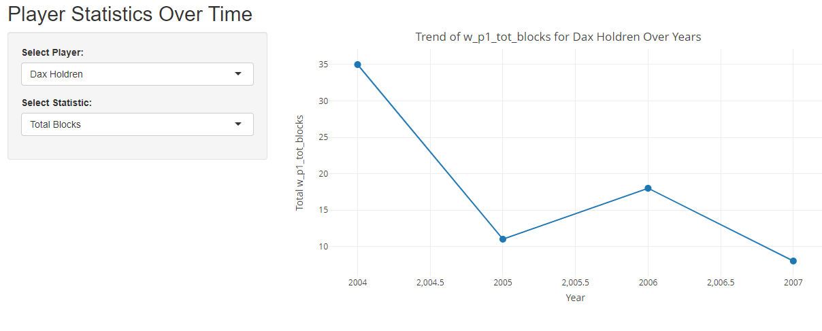

Slide 39
PLAYER STATISTICS OVER TIME
Insights:
The results demonstrate the peak performance periods in a standout year for certain players. Also, shows the shift and change in key performance metrics with some players always improving while others show changeable performances over the years.
Formed Decision:
The decisions must focus on tracking the performance metrics for players over time to identify the potential areas for improvements. Also, put long-term plans for player developments on the weak metrics and adjust based on the changeable performance trends.

Slide 40
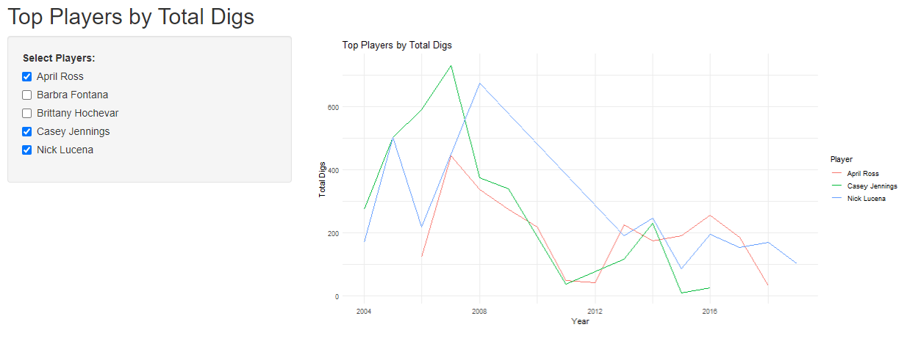

Slide 41
TOP PLAYERS BY TOTAL DIGS
Insights:
The plot shows that certain players always appear at the top of the total gigs which indicates strong defense skills. Also, the players having top dig performance tend to have an important impact on the team's defensive abilities.
Formed Decision:
The decisions should focus on the top dig players by using them as benchmarks to train other players as well as develop a specialized training program for teaching the correct defensive tactics to improve the overall team defense.

Slide 42
THANK YOU!

